Slide 1
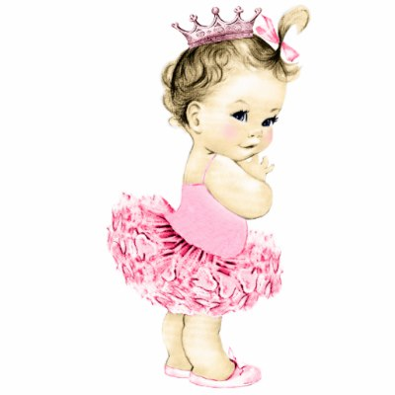

Is There a Relationship Between Baby Names and Movie Characters?
Samantha Maups
Bhargavi Pasarlpati
Linn Slater

Slide 2
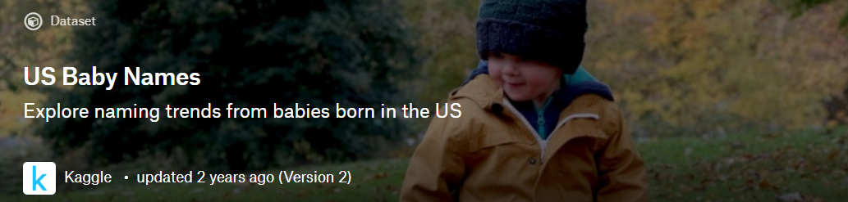
Our Source for Baby Names
Data from Social Security applications
SQLite database with data starting in 1880
Large database size necessitated reducing the data to include fewer years

Slide 3

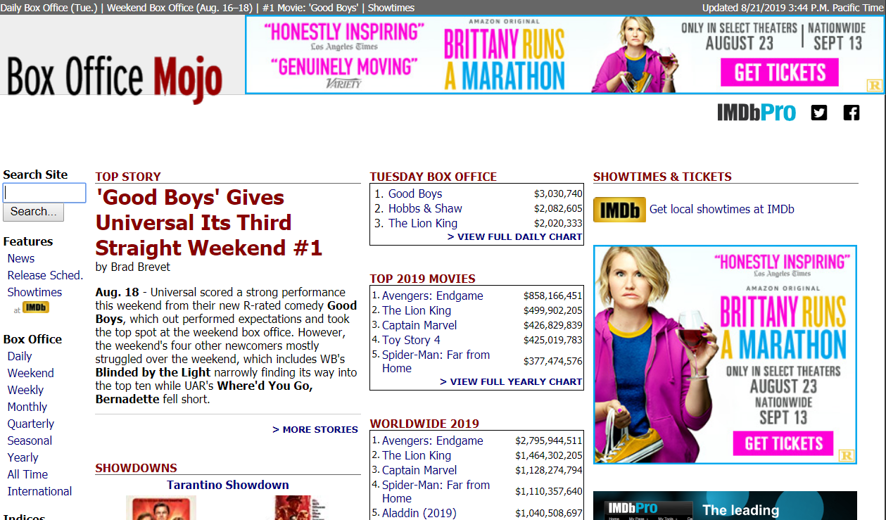
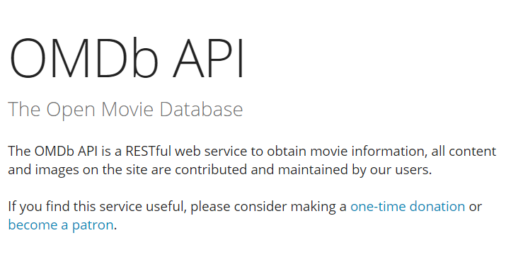
Movie Data Sources

Slide 4
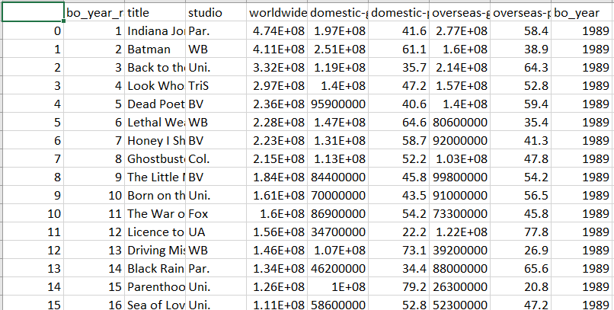
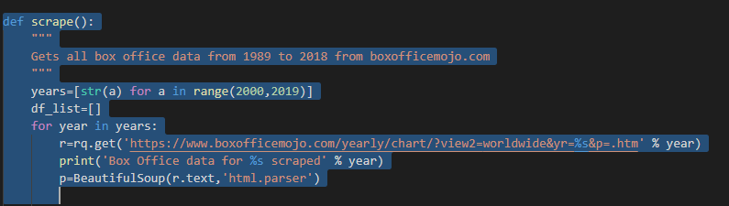
Gathering the Movie Data
Top grossing movies from Movie Mojo

Slide 5
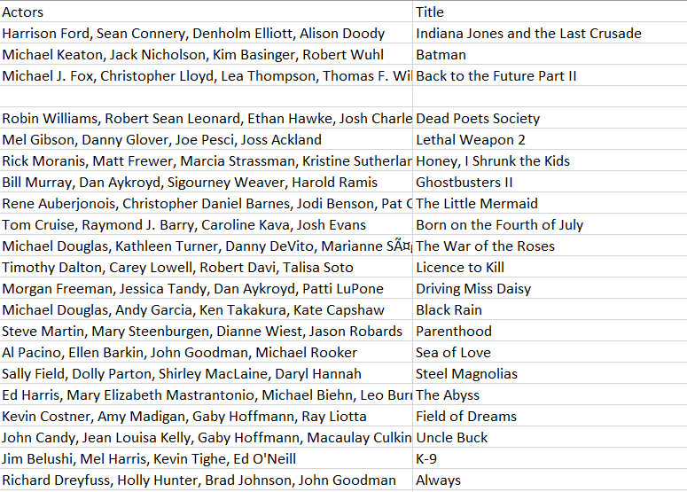
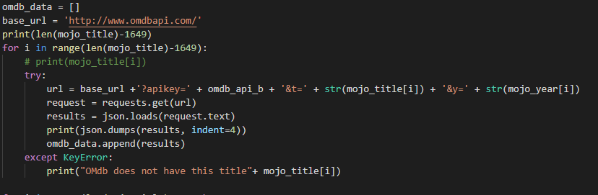
Gathering the Movie Data
Title and actor names
from OMDb

Slide 6
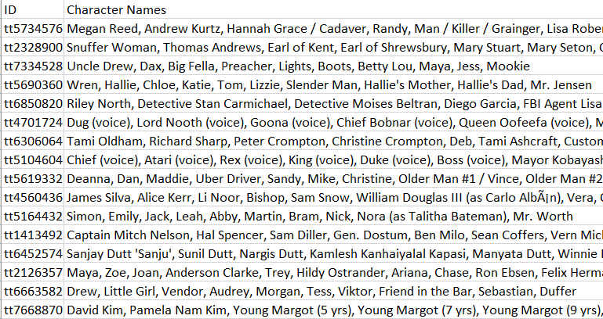
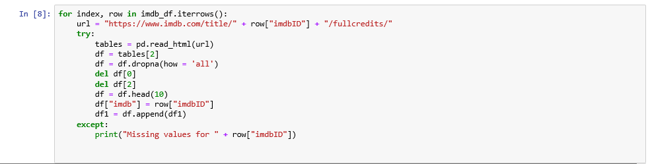
Gathering the Movie Data
ID and character names from IMDb

Slide 7
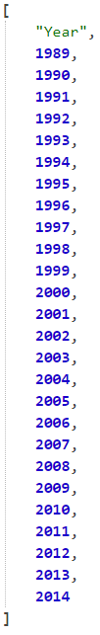
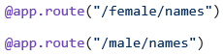
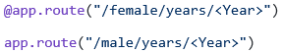
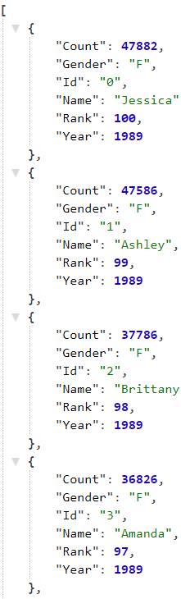
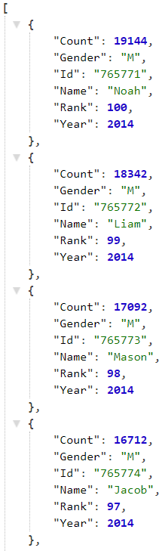
Examples of Our Many Routes
The top baby names are ranked number 100
The baby names in the SQLite database included the years 1989 - 2014

Slide 8
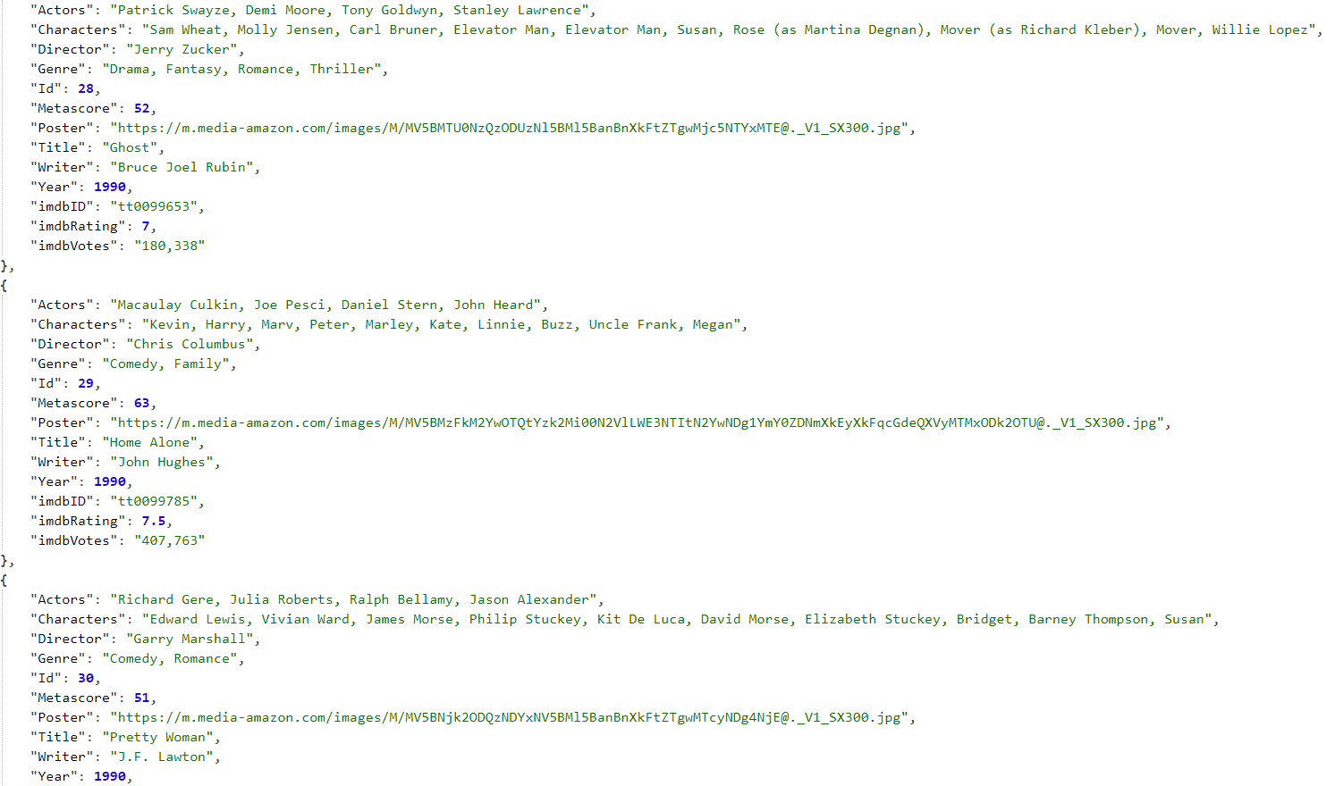
Ratings range from 0 to 10

Slide 9
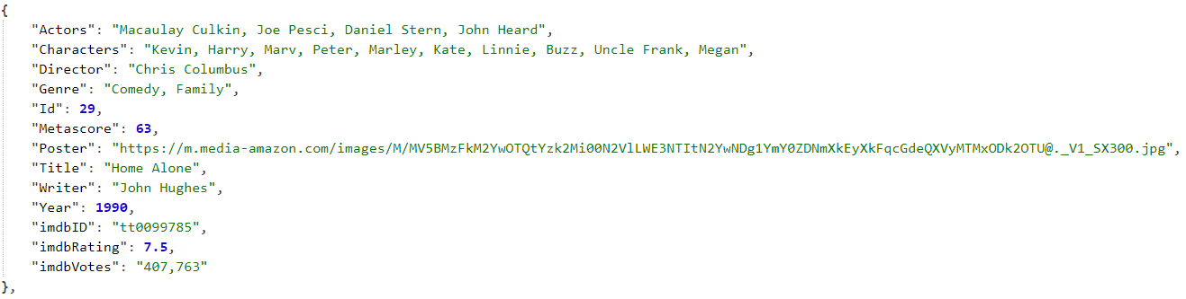
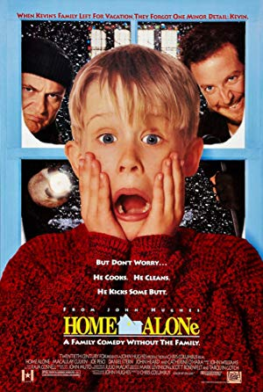
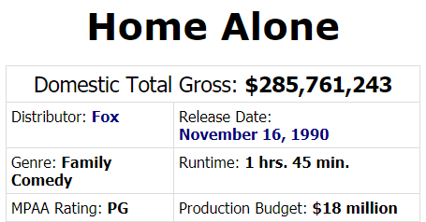
“Home Alone” in 1990

Slide 10

What is the Highest Rated IMDb Movie?
Sorted by IMDb Rating Descending
The Shawshank Redemption (1994) R | 142 min | Drama. ...
The Godfather (1972) R | 175 min | Crime, Drama. ...
The Dark Knight (2008) PG-13 | 152 min | Action, Crime, Drama. ...
The Godfather: Part II (1974) ...
The Lord of the Rings: The Return of the King (2003) ...
Pulp Fiction (1994) ...
Schindler's List (1993) ...
12 Angry Men (1957) ...
Ratings began in 1950 and are a weighted average based on votes

Slide 11
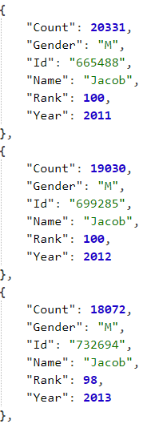

Jacob was the top baby boy name every year from 1999 through 2012 (13 years)

Slide 12
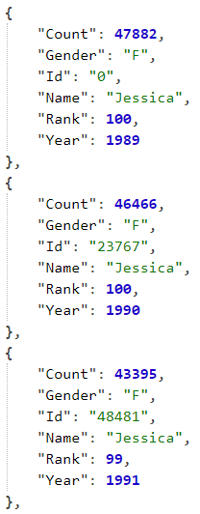

Jessica was one of the top ten baby girl names from 1989 through 2000 (12+ years)

Slide 13
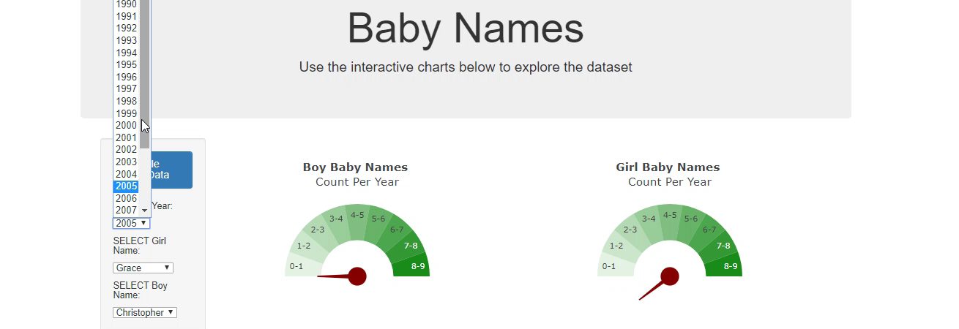
Gauge Charts

Slide 14
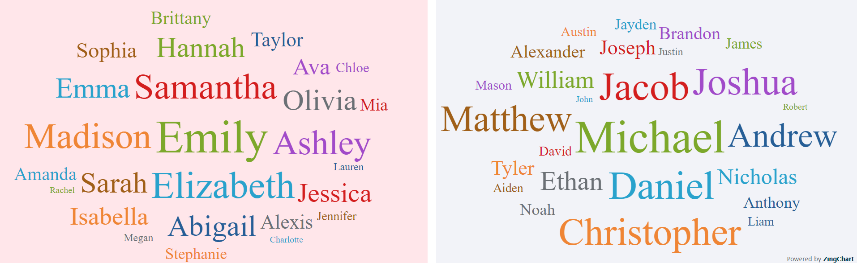
Top Ten Baby Names From 1989 - 2014
new library

Slide 15
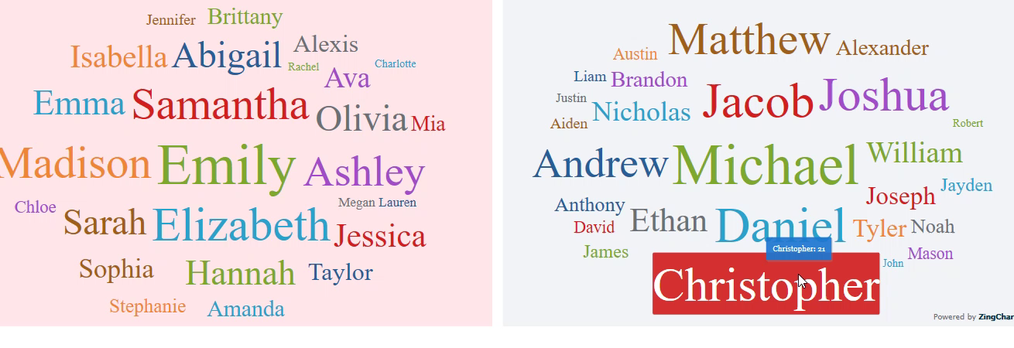
Top Ten Baby Names From 1989 - 2014

Slide 16
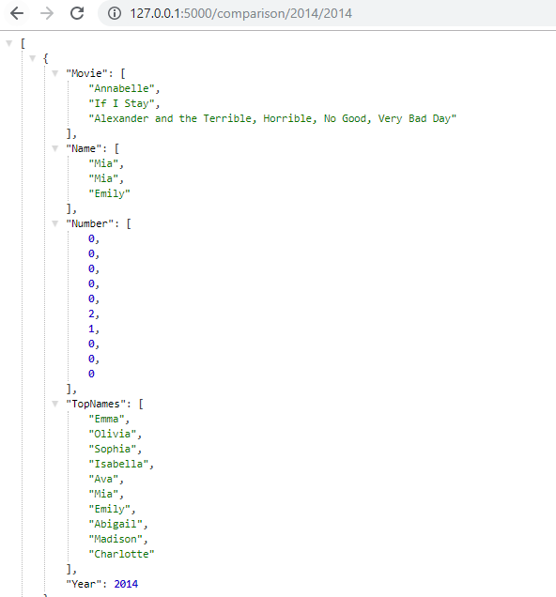
Conclusions
Comparison Data for 2014 : Movie Character
Names Matching Girl Baby Names

Slide 17
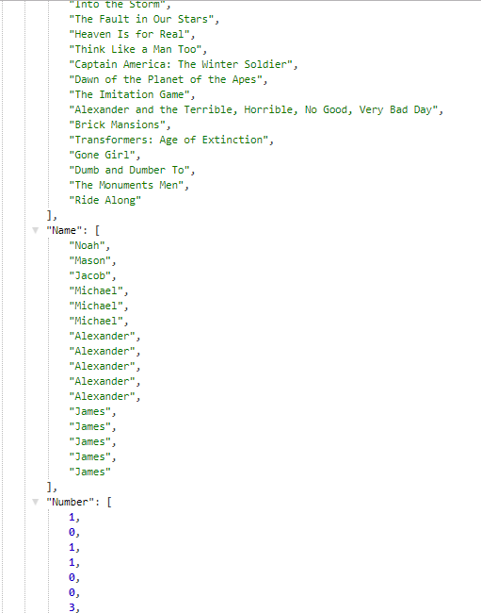
Comparison Data for 2014 : Movie Character
Names Matching Boy Baby Names

Slide 18
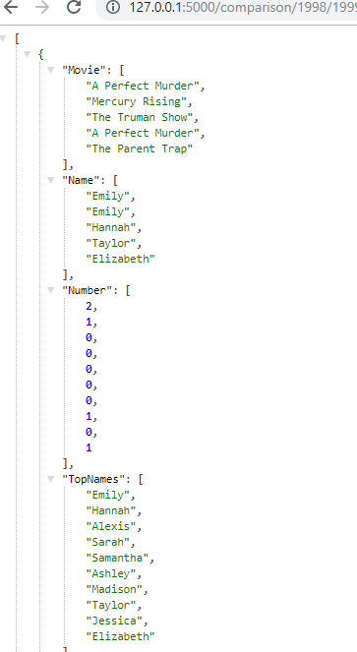
Comparison Data for 1998 : Movie Character
Names Matching Girl Baby Names for 1999

Slide 19
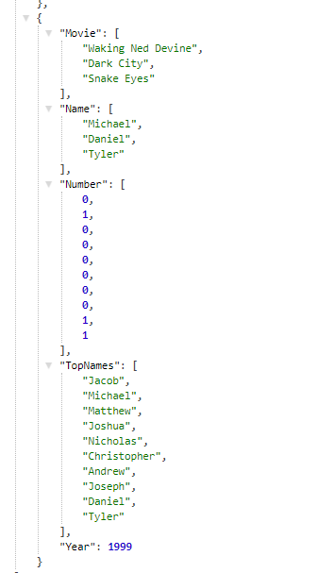
Comparison Data for 1998 : Movie Character
Names Matching Boy Baby Names for 1999

